Slide 1
Portfolio assessment
Statistical Concept and Critical Awareness

Slide 2
THE REPORT
Data summary:
Three dataset were introduced in order to access the comprehensive understanding of some statistical techniques and their application. A global dataset of water temperature, a classical N, P, K (nitrogen, phosphate, potassium) factorial experiment and The classic Box & Jenkins airline data. Monthly totals of international airline passengers, 1949 to 1960 were introduced in order to test how statistical concepts show significant solution to real life problems
Aim:
Demonstrating some statistical concepts on our introduced dataset in order to gain a comprehensive understanding and critical awareness of their application to real life problems
Evidence:
All dataset collected and being tested were originated from a reliable source (R studio and kaggle) therefore each dataset is being used to demonstrate the use of statistical concept (to be shown in the R markdown)

Slide 3
ASSUMPTIONS AND PROCUREMENT
Assumptions:
For the first dataset, Recent significant warming of water temperatures have raised unclear doubts about what factor contributes to this effect. Are there any concluding factors or there's a change in a particular factor leading to this effect?.
Second dataset, the N,P,K factorial experiment demonstrate the yield of each block based on some combination of fertilizer listed above, is there any significant difference or interaction between this fertilizer?
Third dataset, a monthly time series data displaying air passenger each month from the year 1949-1960, does air passengers varies each month or does time (month or year) have any effect on the number of air passenger
Procurement:
After studying our dataset and identifying the problems based on our assumptions being backed with evidence, easy and fast treatment should be applied to factors acclaiming the problems therefore the aim is to better understand the causes and effect to the changes in our ecosystem structure and function

Slide 4
Technique, Justification and Conclusion
Technique:
Different technique are introduced to each dataset which are Hypothesis Testing, Linear Regression, Post Hoc test, Analysis of variance and Ljung-Box
Justification:
Each factor of every dataset introduced were tested and assumption were checked (shown in the R markdown), showing the statistical concept are broadly used and correctly tested
Conclusion:
Every statistical technique have its own unique purpose and clearly stated. Therefore statistical concept can be use to solve real life problems in any field (engineering, agriculture, transportation, medicine and so on)

Slide 5
CASE STUDIES
ASSESSMENT

Slide 6
COMPREHENSIVE UNDERSTANDING OF SOME STATISTICAL TECHNIQUES
Descriptive Statistics: it refers to collecting, organizing, analyzing and summarizing data sets in an understandable format like charts, graphs and tables. It makes a large data set presentable and eliminates complexity to help analysts understand it. The format of the summary can be quantitative or visual
Inferential Statistics: Inferential statistics derive inference about a large population. It is based on the analysis and findings produced for sample data from the large population. Hence it makes the process cost efficient and time efficient. It generally includes the development of interval estimate and points estimate and points estimate to conduct the analysis
Mean: it is one of the simplest and most popular analysis methods easy to apply to data. The mean is the average value of data used in research. In statistics, the term ‘mean’ is commonly used to indicate average. It is calculated by adding the data values and dividing them by the total number of data points, though it is a common method, it is advised to have other methods supporting it for effective decision making.

Slide 7
Regression and Hypothesis
Regression: The regression method helps comprehend the relationship between two or more variables used in the analysis. It shows how one variable is dependent on the other and their inter effect on each other. There is simple linear regression using a single independent variable to interpret the dependent variable and multiple linear regression using multiple independent variables to interpret the outcome
Hypothesis Testing: The method tests the validity and authenticity of a hypothesis, outcome or argument. Hypothesis testing is an assumption set at the beginning of the research, after the rest is over and a result is obtained based on it, the belief can be either true or false. In addition, it can check whether the null hypothesis or alternative hypothesis is true.
Null Hypothesis: The null hypothesis is considered an accepted truth. It assumes that the research is false, that the observations are caused by random factors. Researchers must prove the null hypothesis wrong to prove their alternative hypothesis
Alternative Hypothesis: is considered as rejected truth. It also assumes that the research is true therefore the observations are not caused by random factors. We must show the alternative hypothesis is true to prove that the null hypothesis is wrong

Slide 8
ANOVA, POST-HOC TEST AND LJUNG-BOX TEST
ANOVA: Analysis of Variance is a statistical formula used to compare variance across the means of different groups. A one-way anova uses one independent variable while two-way anova uses two independent variables
Post-Hoc Test: is a statistical analysis specified after a study has been concluded and the data collected. A Post-Hoc test is done to identify exactly which groups differ from each other. Therefore, such tests are also called multiple comparison test.
Ljucg-Box Test: is a statistical test that checks if autocorrelation exist in a time series data

Slide 9
STATISTICAL APPLICATION TO REAL LIFE PROBLEMS
Electrical Engineering: Statistical techniques helps us to characterize circuits and systems, perform digital signal processing and deal with the omnipresent and perpetually troublesome electrical signals that we call noise.
Geospatial: Statistical analysis is also used to identify and confirm spatial patterns, such as the center of a group of features, the directional hand, or weather features form clusters, While patterns may be apparent to a map, trying to draw conclusion from a map can be difficult. Statistical functions analyze the underlying data and give you a measure that can be used to confirm the existence and strength of the pattern

Slide 10
GLOBAL DATASET OF WATER TEMPERATURE
TEST STATISTICS

Slide 11
DATA SUMMARY AND HYPOTHESIS TESTING
Data Summary:
A quick Exploratory data analysis in R shows us some vital information for examples we have 288 lakes and 60 reservoir being tested and United States being in the top location tested with 83 samples followed by Canada having 45 samples and Australia 31 samples and many more other location being tested. This shows we have collected samples from a lot of region like North America, Europe, Asia, Oceania and many more.
Hypothesis Testing:
H0: Only one factor have effect the geospatial accuracy of lake
H1: All factor contributes have effect on the geospatial accuracy of lake

Slide 12
TECHNIQUE AND DISTRIBUTION
Technique Applied:
Our dataset contains one dependent variable (Geospatial) and more than one independent variable. we need to determine the relationship between these variables. Regression analysis also helps to understand how dependent variable change when one of the independent variable is change and other independent variable are kept constant
Distribution Checking:
Plotting our Normal Q_Q plot of our fitted model to shows what type of distribution our dataset assumed to follow

Slide 13
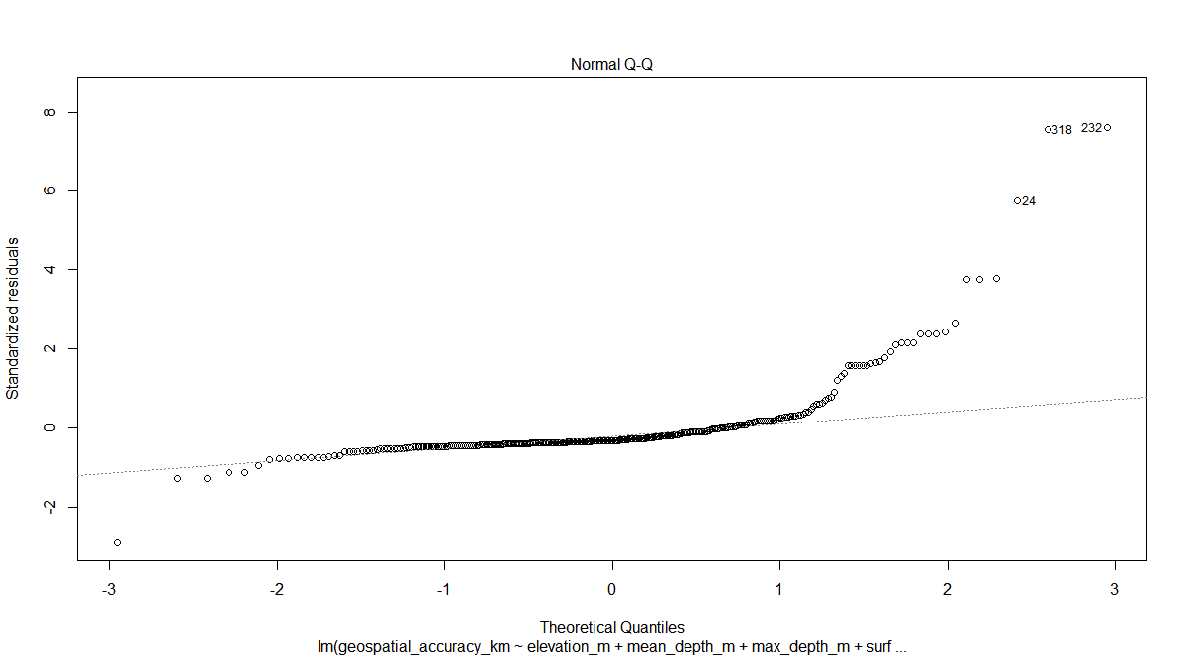
NORMAL Q-Q PLOT

Slide 14
RESULT AND CONCLUSION
Distribution:
Its therefore confirmed that our data is not normally distributed therefore little analysis approached are applied and tested
Result:
After fitting our linear model and taking a look at the summary. we discover only the variable (elevation) shows significant impact on our dependent variable (geospatial accuracy) having a very low p-value.
Conclusion:
Since Elevation shows significant effect on our geospatial accuracy, this says countries with high elevation have more geospatial accuracy. To back up and test our result. We need to compare the geospatial accuracy of region to show whether region with high elevation really have high geospatial accuracy

Slide 15
ASSUMPTION AND REGION TESTING
Region Testing:
Checking and sorting our variable (region) in respect to variable (elevation). we can deduct that most countries with high elevation have good geospatial accuracy and only few with low elevation shows good spatial accuracy. so therefore our assumption and hypothesis appears to be true
Result
Our dataset is being sorted in descending order (available in the R markdown) to show countries with the highest elevation and geospatial
Justification:
Based on our dataset and hypothesis testing, we can assume that countries with high elevation where the lake or reservoir presides will probably have significant ecosystem effect if there ought to be a defiling agent to their reservoir and lakes .

Slide 16
CONCLUSION
Conclusion:
Our dataset have lead us to a final conclusion and derivation showing countries with high elevation should monitor their water temperature more effectively and forecast any other defiling agent that can lead to rise in their respective lakes and reservoir. It also shows that other variable have effect on the water temperature but not as significant as elevation of the city.

Slide 17
N,P,K Factorial Experiment
TEST STATISTICS

Slide 18
Data Summary
Data Description
A classical N, P, K (nitrogen, phosphate, potassium) factorial experiment on the growth of peas conducted on 6 blocks. Each half of a fractional factorial design confounding the NPK interaction was used on 3 of the plots.
Source
Imperial College, London, M.Sc
Key Value:
block : label (1 to 6)
N: indicator (0/1) for the application of nitrogen
P: indicator (0/1) for the application of phosphate
K: indicator (0/1) for the application of potassium
yield : Yield of peas, in pounds/plot (the plot were (1/70) acre)
0= not applied, 1= applied

Slide 19
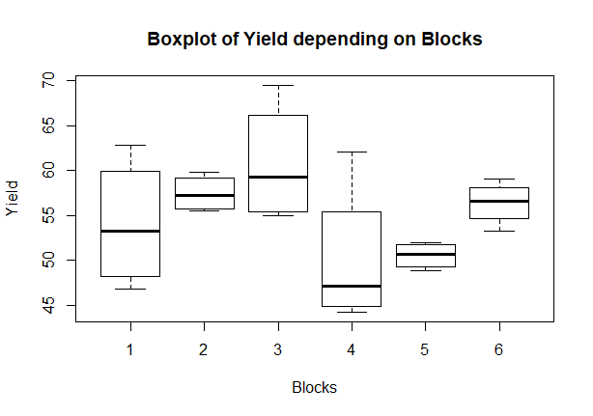
Data Visualization

Slide 20
Interpretation and Hypothesis testing
Interpretation
The box plot diagram shows that block 3 have the highest yield with the minimum treatment used while block 4 have the lowest yield with maximum treatment while other blocks have similar yield and treatments
Hypothesis Testing:
H₀ = The fertilizers have effect on the growth of peas
H₁ = The fertilizer does not have effect on the growth of peas
Technique applied:
Since the data follows Randomized Complete Block Design, we are going to apply anova model to the data and then plotting post hoc for our result to test for difference in groups

Slide 21
Result
Result:
Taking a look at the result, N:P, N:K, N:P:K have a high sum-of-square value which means there is much variation that can be explained by the interaction between nitrogen and phosphate and potassium
Meanwhile, P:K has low sum-of-square value showing there is not much variation in the interaction between phosphate and potassium only
Conclusion:
Therefore, we conclude that nitrogen and potassium have a high effect on the yield due to high value of sum-of-square and low p value, while phosphate does not really add much
With this, let perform a post-hoc test to find out which group are statistically different from one another in order to test for our assumption

Slide 22
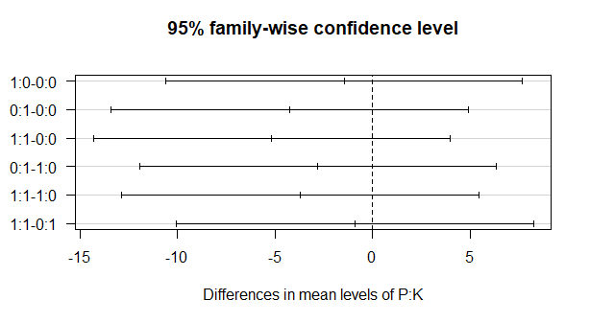
Visualizing the Post Hoc test

Slide 23
Interpretation
Interpretation:
From the graph above, we can see that the fertilizer P:K combinations have no effect on the block. so basically every other fertilizer combination mentioned above have significantly effect on every block
Please note: Comprehensive diagram is available in R markdown
Decision:
Since the p value of each fertilizer shows good significant value and the fertilizers variable shows much variation that can be explained by the interaction between the fertilizers and block and only P:K have no effect. we hereby do not reject H₀.
Conclusion:
The fertilizers have great effect on the growth of peas on each block

Slide 24
MONTHLY AIRLINE PASSENGERS
Test Statistics

Slide 25
DATA SUMMARY AND HYPOTHESIS TESTING
Data Desciption:
The classic Box & Jenkins airline data. Monthly totals of international airline passengers, 1949 to 1960 showing monthly times series, in thousands
Source:
Box, G. E. P., Jenkins, G. M. and Reinsel, G. C. (1976) Time Series Analysis, Forecasting and Control. Third Edition. Holden-Day. Series G
Hypothesis Testing:
H0 : Number of Air passengers increases with time
H1: Number of Air passengers decreases with time
Performing EDA:
Our data is in time series format. We intend to check if there is any trend our dataset

Slide 26
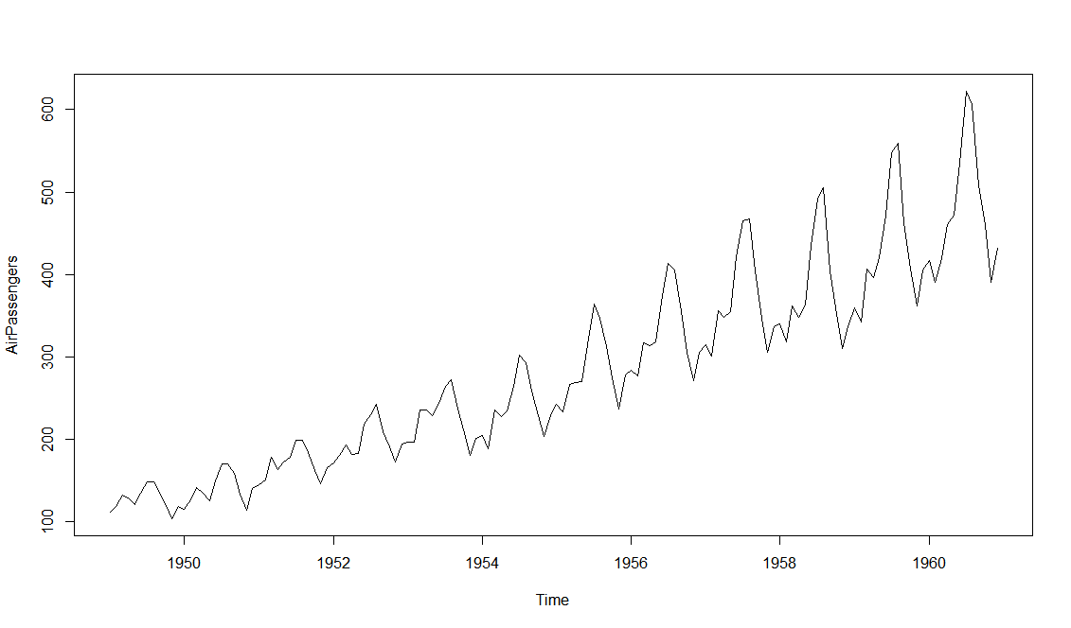
VISUALIZING OUR DATASET

Slide 27
Interpretation, Conclusion and Decision
Interpretation:
After plotting our dataset. It appears our dataset contains trends and the trend to be identical. This tells us our data is not stationary which shows Air passengers increases as time goes on , we check for Ljung Test to see if the test statistics (X­-squared) gets larger with time. We intend to check residual are independently distributed .
Ljung Box-test interpretation:
Having p-value =1 shows our residual is independently distributed then backs our assumption that air passengers increase with time
Decision:
Since our data contains trend and therefore not stationary, we backed our result with Ljung-Box test to show the probability that number of air passengers will continue to rise with time
Conclusion:
There’s increase in Air Passenger over time.

Slide 28
FORMATIVE ASSESSMENT
TEST STATISTICS

Slide 29
REFERENCE
www.dataone.org
BMC Health Services Research
https://www.g2.com/articles/qualitative-vs-quantitative-data
Sapna Sharma, Derek Gray, Jordan Read, Catherine Oreilly, Philipp Schneider, et al. 2022. Globally distributed lake surface water temperatures collected in situ and by satellites; 1985-2009.
LTER Network Member Node. https://pasta.lternet.edu/package/metadata/eml/knb-lter-ntl/10001/4.

